Slide 1
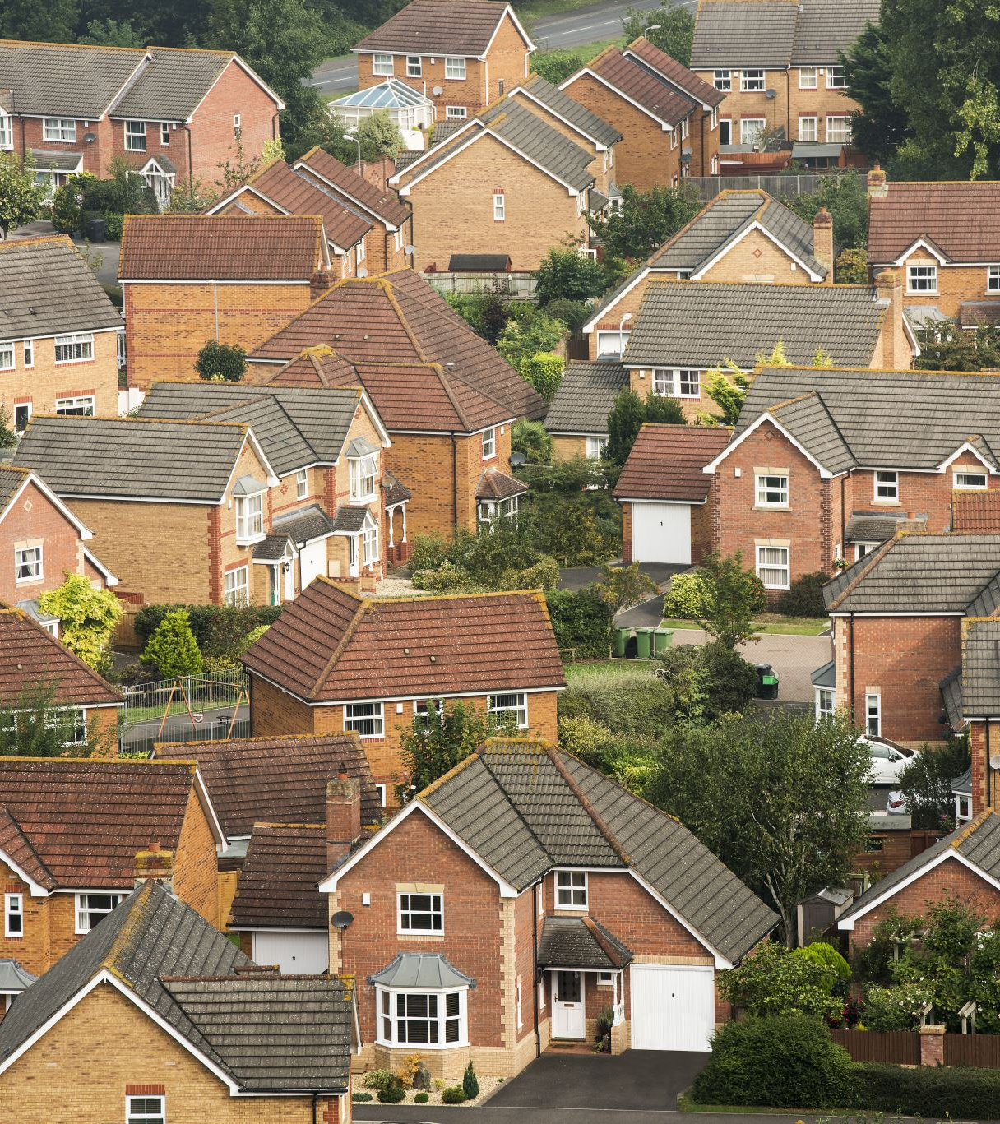
Neighborhood traits explain some variation in housing prices.
Ben Warren and Jun Sik Kim
Notes:
JS

Slide 2
Highlights
Data sets from diverse sources like the American Community Survey, city/county open data sites, and the Bureau of Justice Statistics shed light on important neighborhood characteristics.
Median income, educational attainment, and racial demographics are some of the neighborhood features that most influence home prices.
Location is important, but it isn’t everything. There is significant variation in home sales within neighborhoods.
Notes:
JS

Slide 3
Methods
Compiled and harmonized home sales data from 2000-2025 for three U.S. cities – Philadelphia, Detroit, and Pittsburgh.
Gathered data on neighborhood crime, commerce and demographics for each location.
Merged sales and neighborhood characteristics data sets.
Applied linear and non-linear regression techniques to the data set, using neighborhood data as features and the home price as the target column.
Compared explanatory power of different neighborhood features across cities and regression techniques.
Notes:
JS

Slide 4
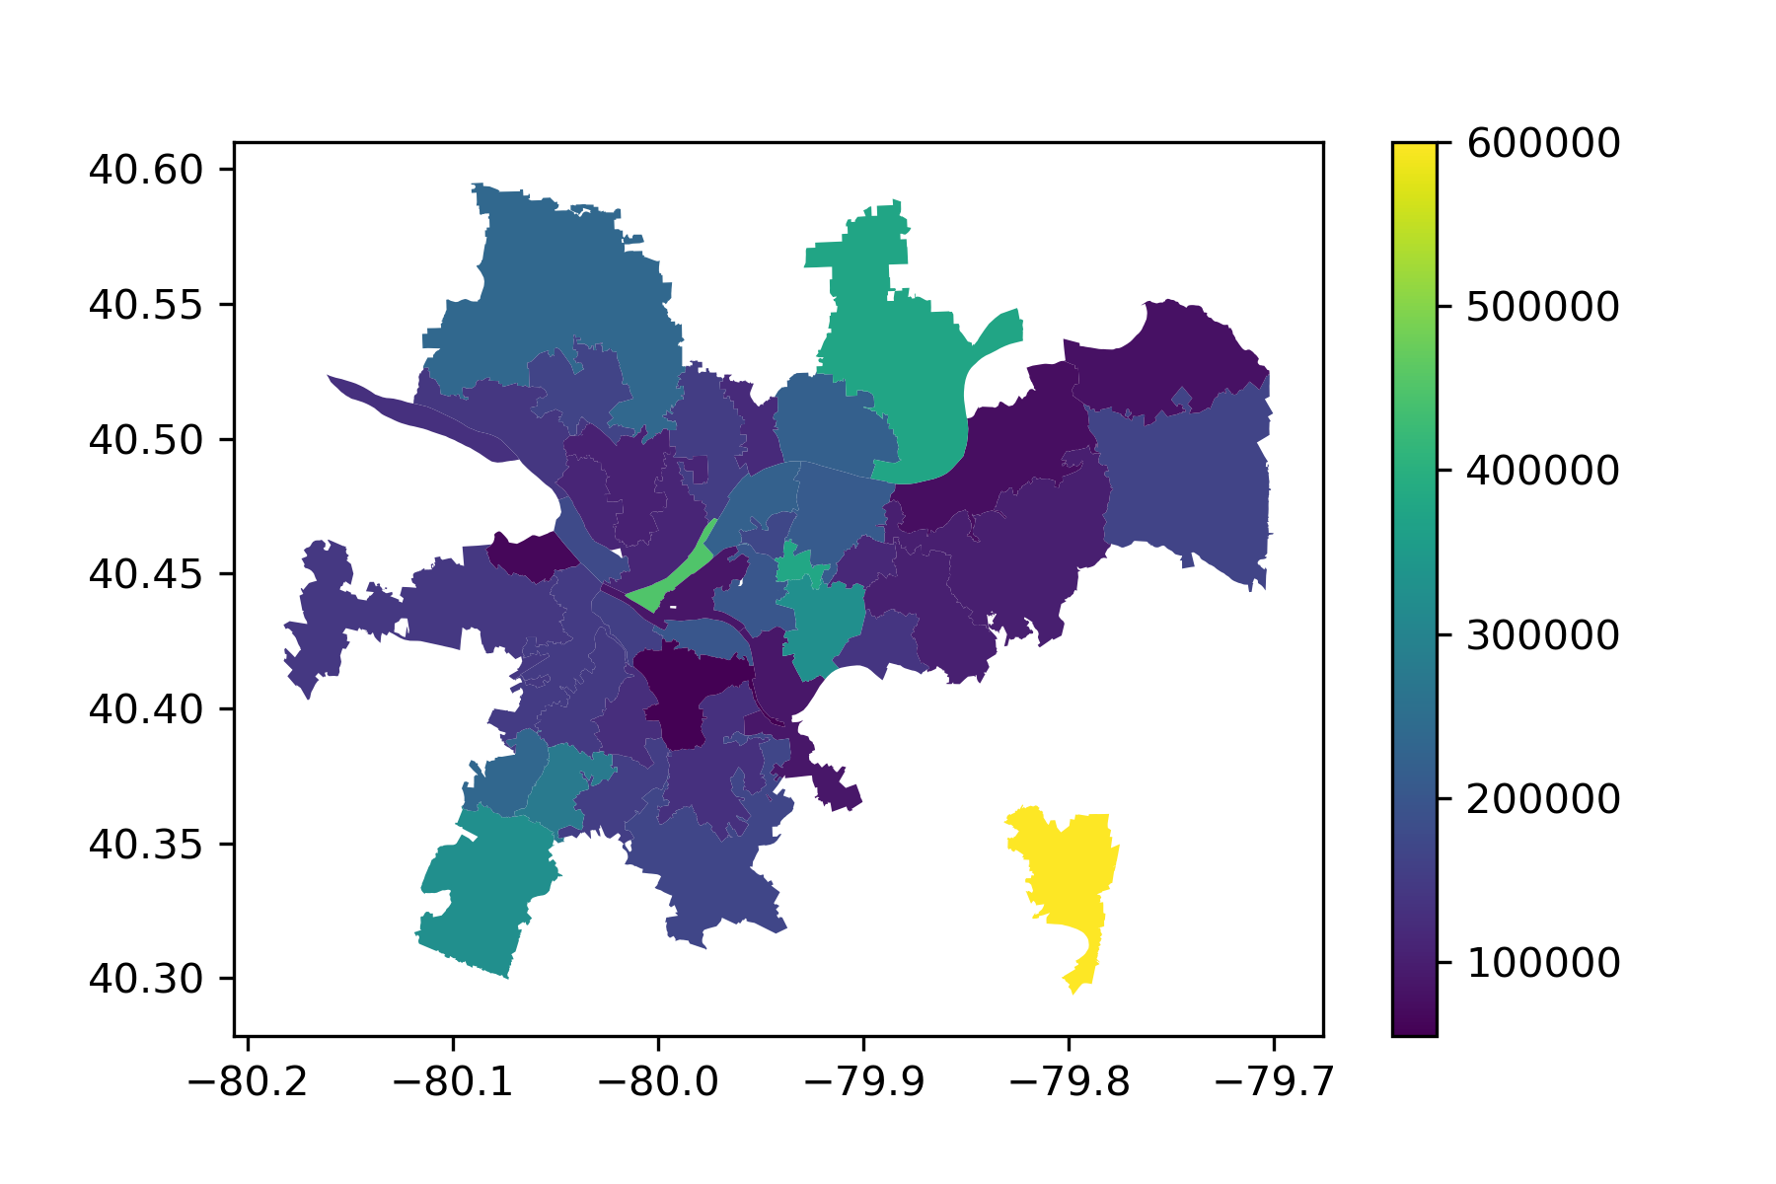
Background
Median Home Sale by Zip Code – Allegheny County, PA
Most research on home prices focuses on characteristics of the home itself – square footage, bedrooms, bathrooms.
Recent advances in the field apply cutting-edge ML techniques like neural networks, decision trees, and support vector machines to this problem.
But, the extent to which neighborhood-level characteristics alone explain home values remains unexplored.
Notes:
JS

Slide 5





Commerce | Total businesses
 | Industry-specific
Crime | Total offenses
 | Property crimes
 | Violent crimes
Demographics | Race/ethnicity
 | Income
 | Employment
 | Education
Sales | Sale date
 | Sale price
Notes:
JS

Slide 6
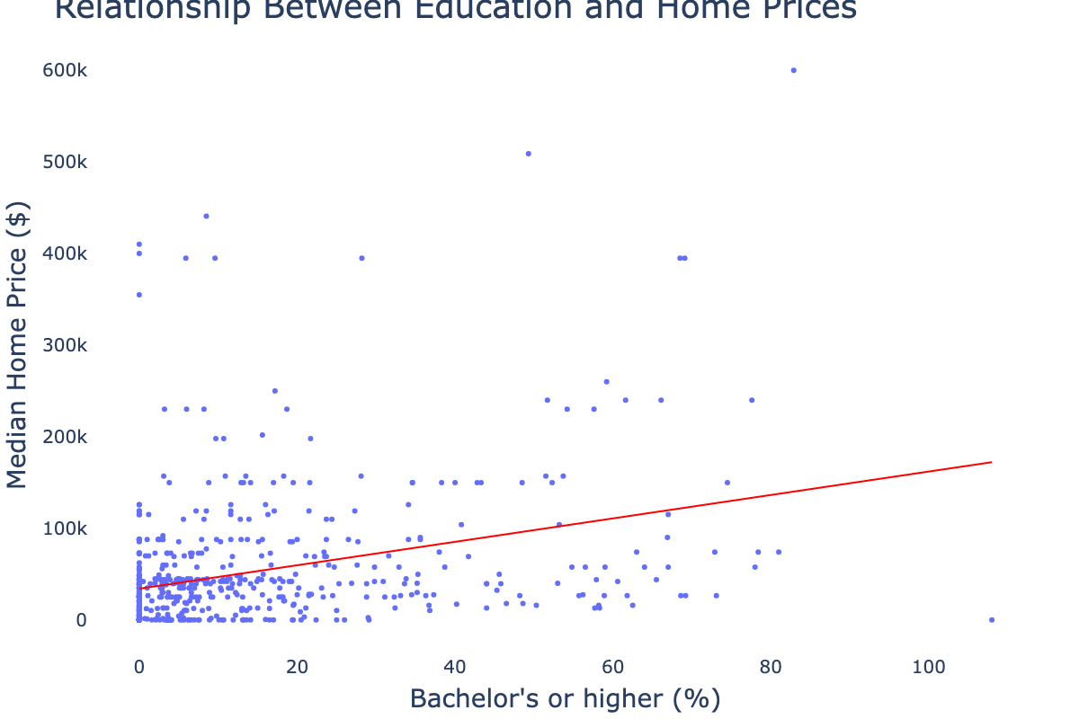
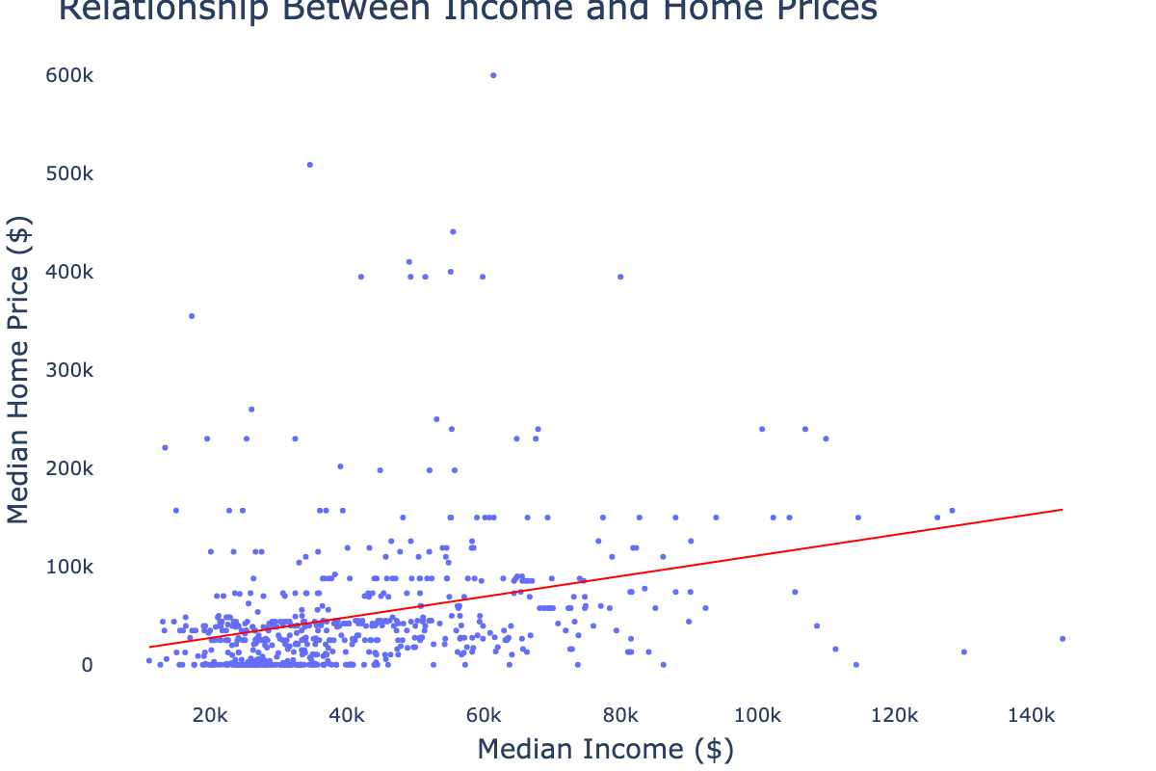
Income and education were correlated with home price.
Notes:
Ben

Slide 7
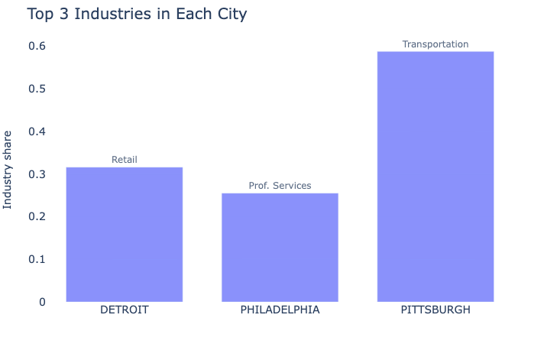
Top industries varied by city.
Notes:
Ben

Slide 8
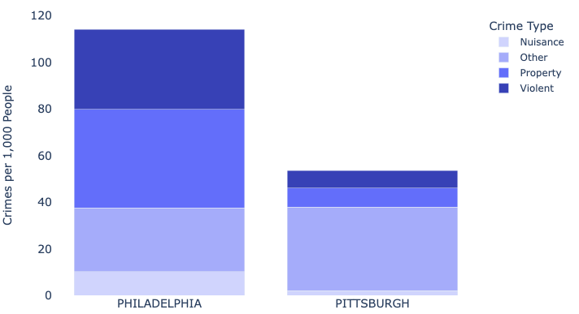
So did crime rates.
Notes:
Ben

Slide 9
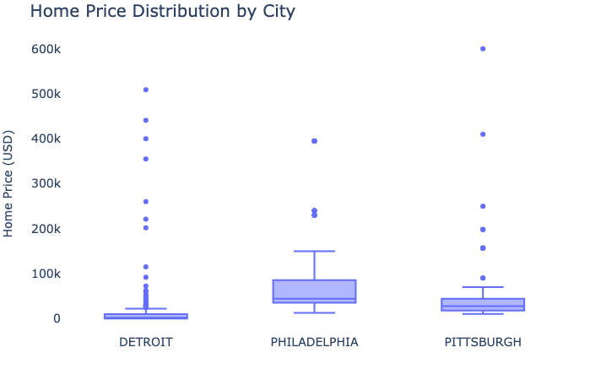
Some locations are more expensive than others…
Notes:
Ben

Slide 10
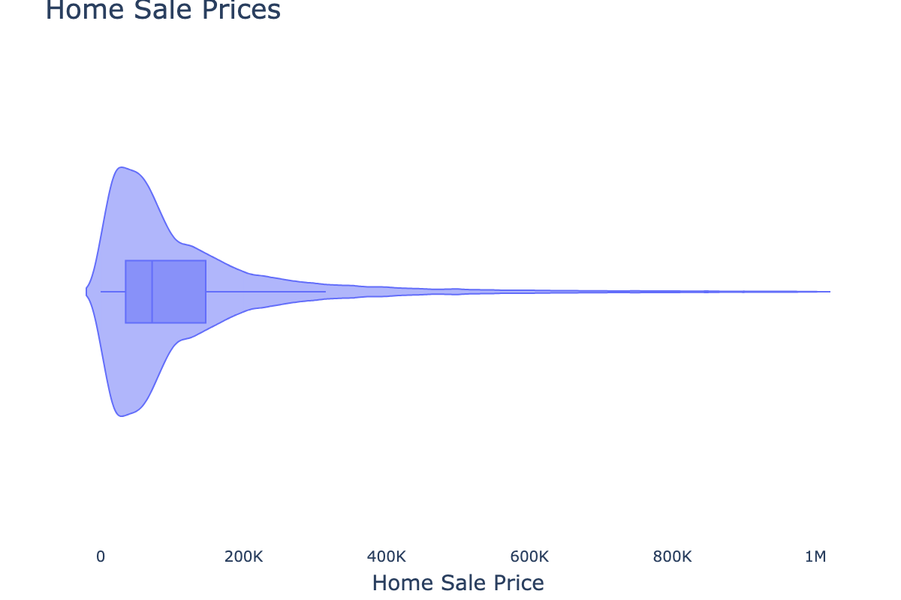
…and homes everywhere vary widely in price.
Median: $72,000
60,000+ homes > $1M
Notes:
Ben

Slide 11
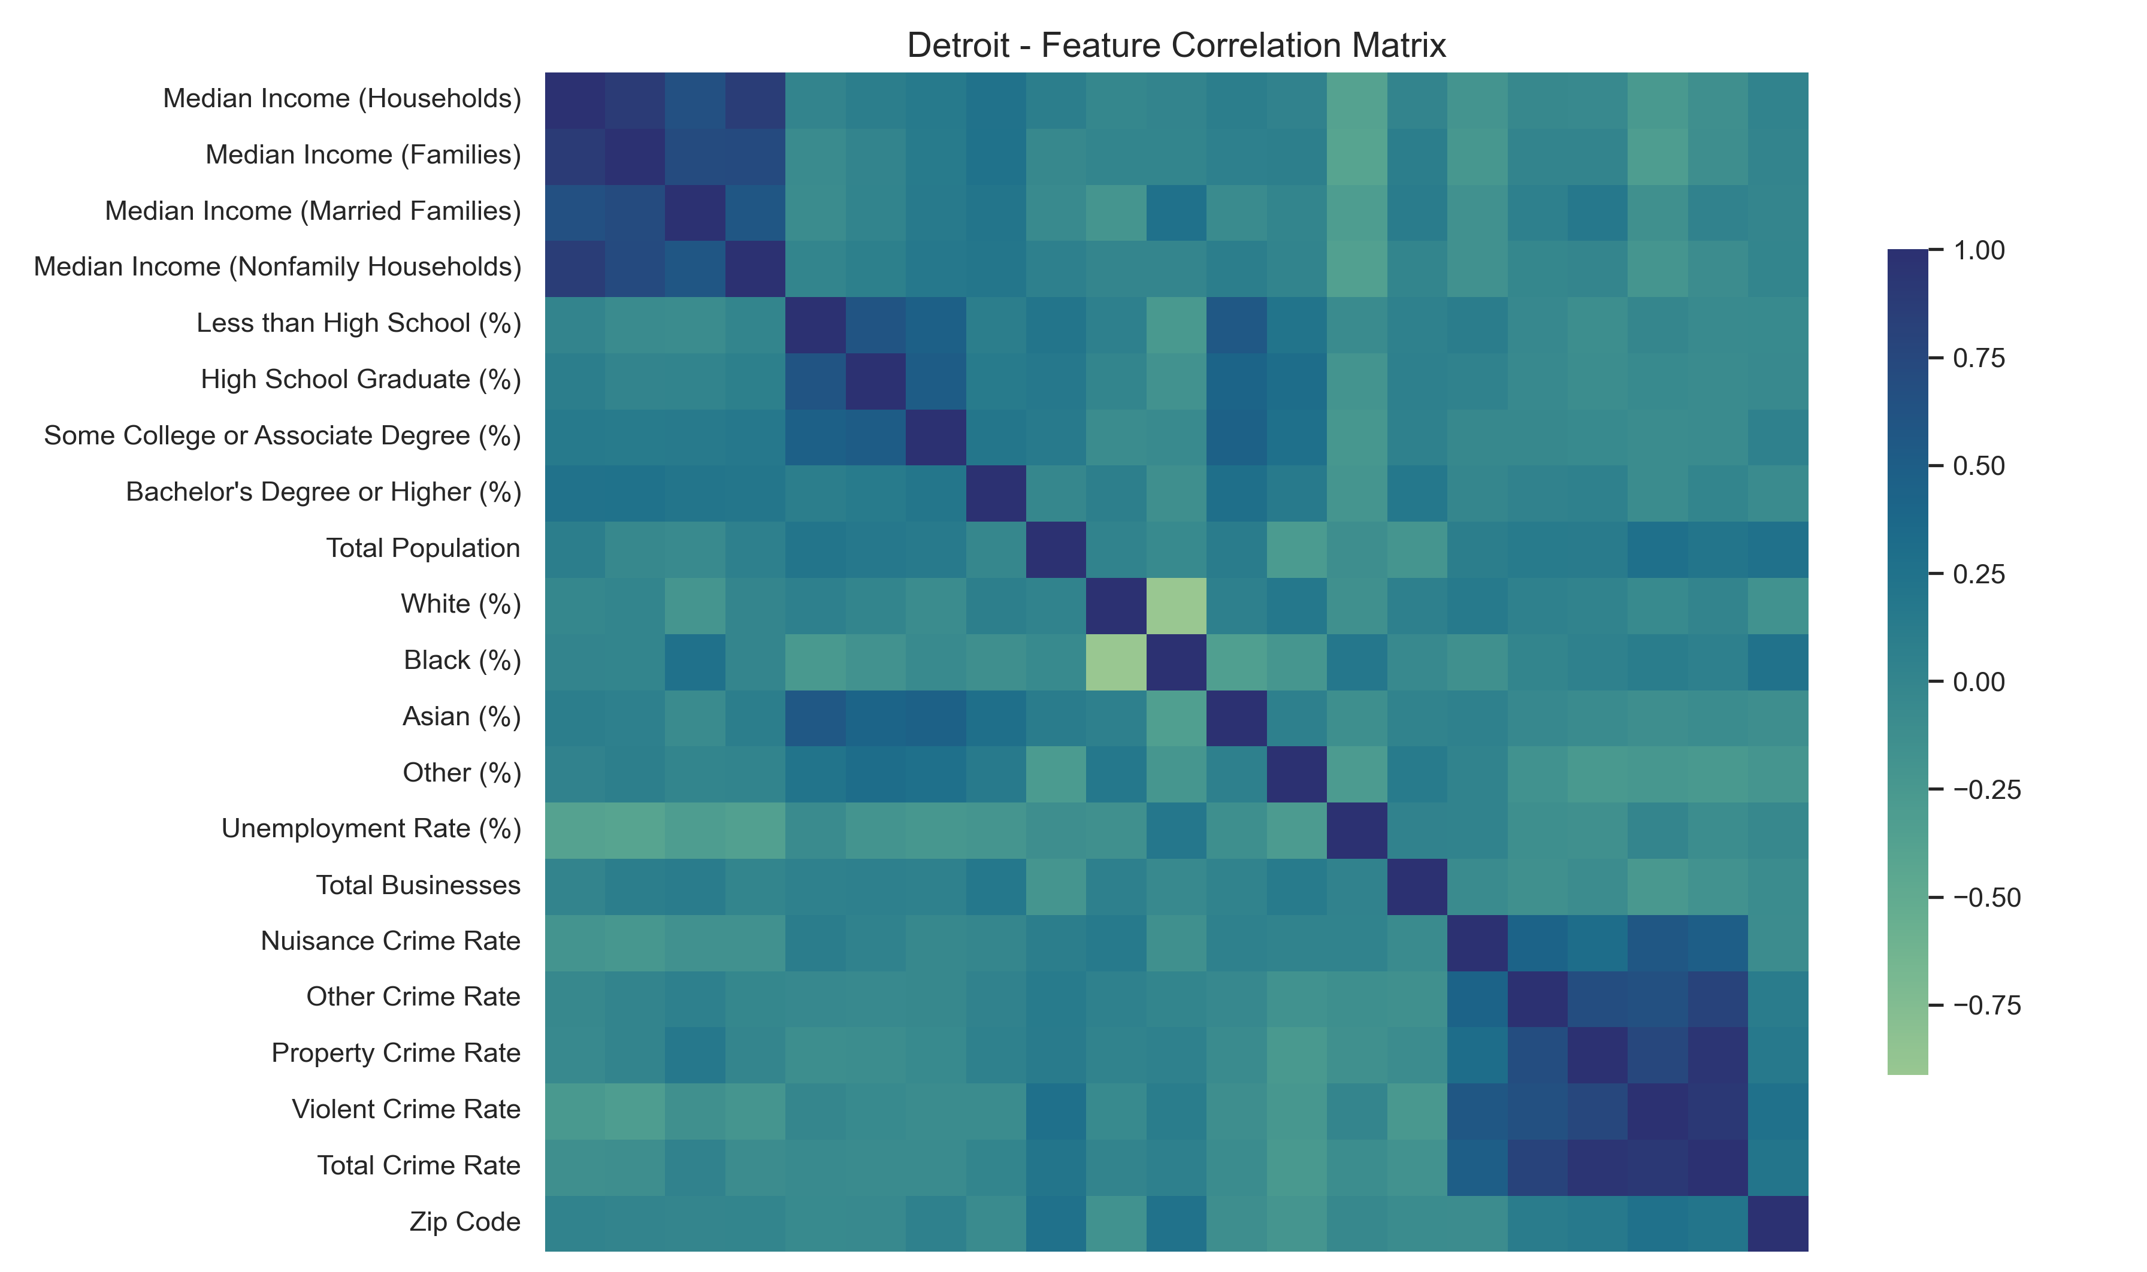
Most features showed low correlation with each other.
Notes:
Ben

Slide 12
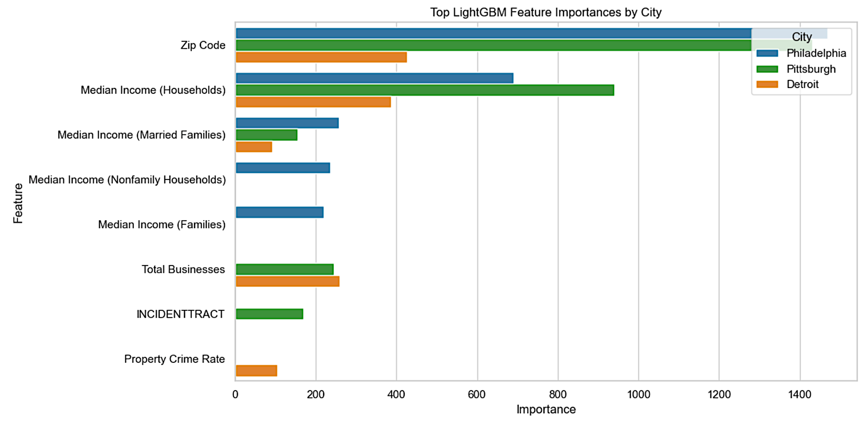
A LightGBM model revealed similar important features to regression models.

Slide 13
Regression Data Sets
Philadelphia
~2,900,000 rows
Pittsburgh
~720,000 rows
Detroit
~285,000 rows
Preprocessing:
Less than high school education as base case for education
Dropped total crime rate and focused on individual crime rates
Focused on Zip Code rather than GEO ID or Census Tract
Sale Price was logged to account for skewness
Ran on 10% of dataset due to large dataset for Random Forest and LightGBM

Slide 14
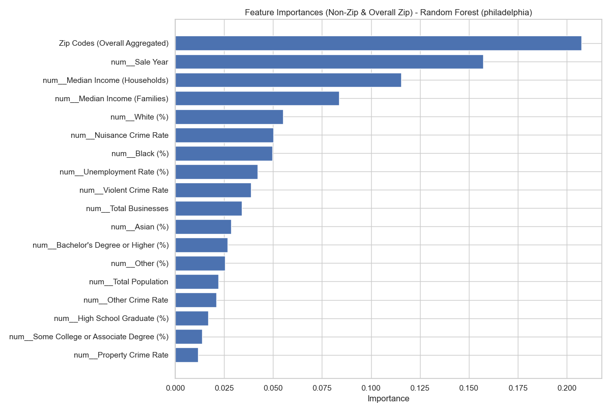
Random Forest Feature Importances Philadelphia (R² : 0.3647)
Zipcode
Sale year
Median Income (Household)
Median Income (Families)
White population %
Nuisance Crime Rate
Black population %
Unemployment Rate %
Violent Crime Rate
Total Businesses

Slide 15
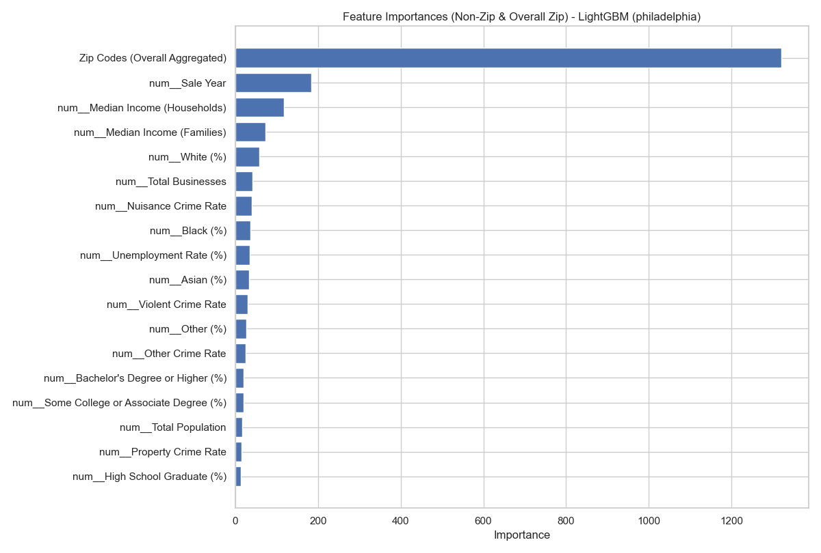
LightGBM Feature Importance Philadelphia (R² : 0.3697)
Zipcode
Sale year
Median Income (Households)
Median Income (Families)
White population %
Total Businesses
Nuisance Crime Rate
Black population %
Unemployment Rate %
Asian population %

Slide 16
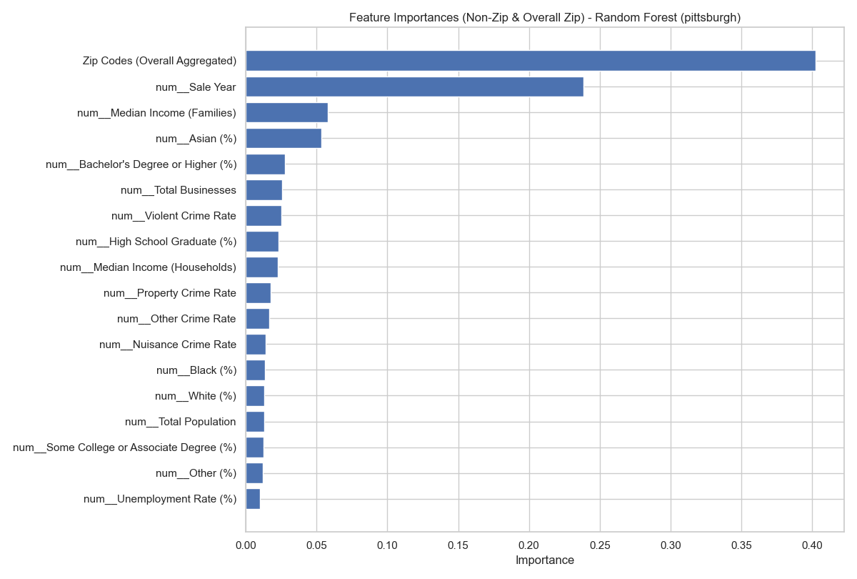
Random Forest Feature Importances Pittsburgh (R² : 0.2823)
Zipcode
Sale year
Median Income (Families)
Asian population %
Bachelor's Degree or Higher %
Total Businesses
Violent Crime Rate
High School Graduate %
Median Income (Households)
Property Crime Rate

Slide 17
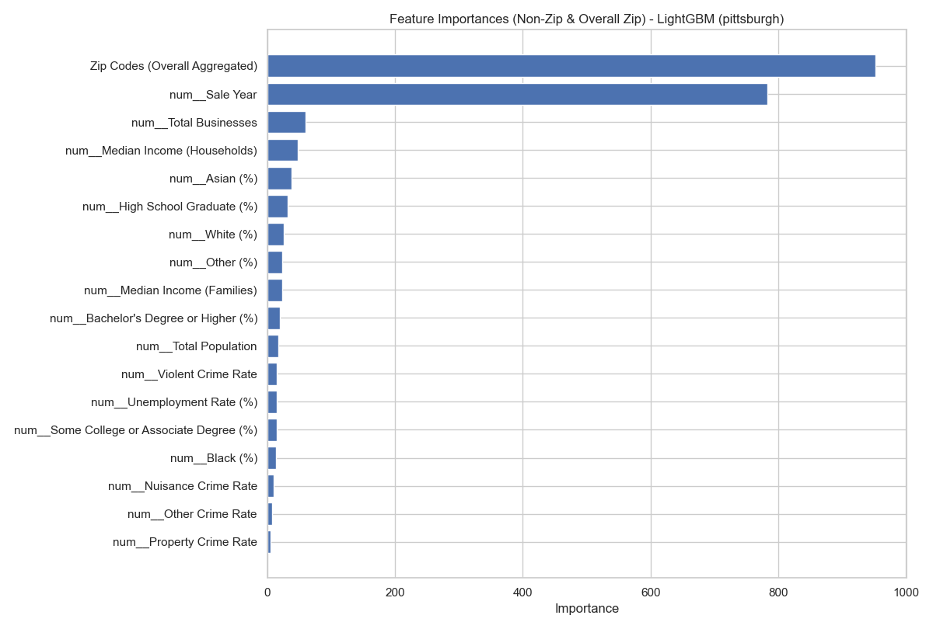
LightGBM Feature Importance Pittsburgh (R² : 0.2840)
Zipcode
Sale year
Total Businesses
Median Income (Households)
Asian population %
High School Graduate %
White population %
Other Race population %
Median Income (Families)
Bachelor's Degree or Higher %

Slide 18
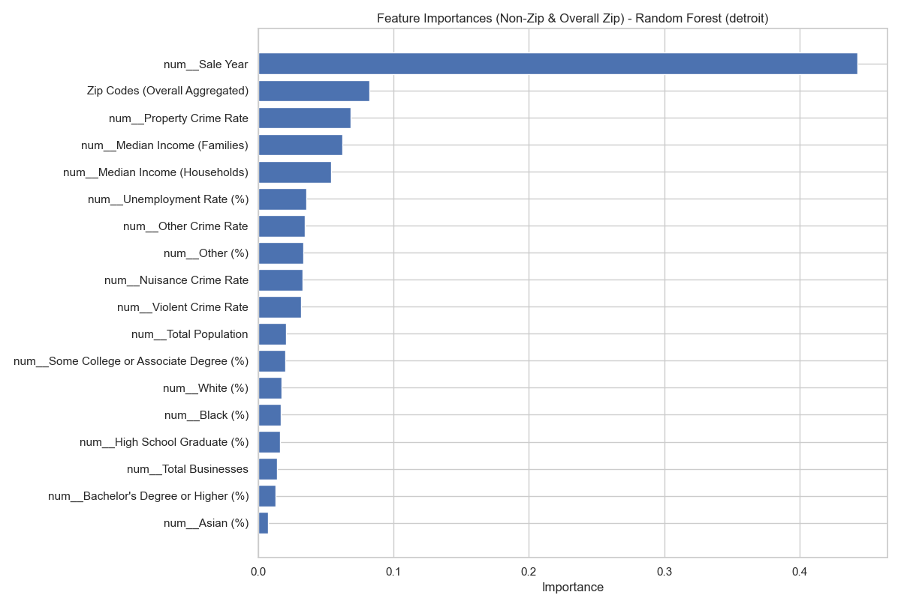
Random Forest Feature Importances Detroit (R² : 0.1072)
Sale Year
Zip Codes
Property Crime Rate
Median Income (Families)
Median Income (Households)
Unemployment Rate %
Other Crime Rate
Other Race Population %
Nuisance Crime Rate
Violent Crime Rate

Slide 19
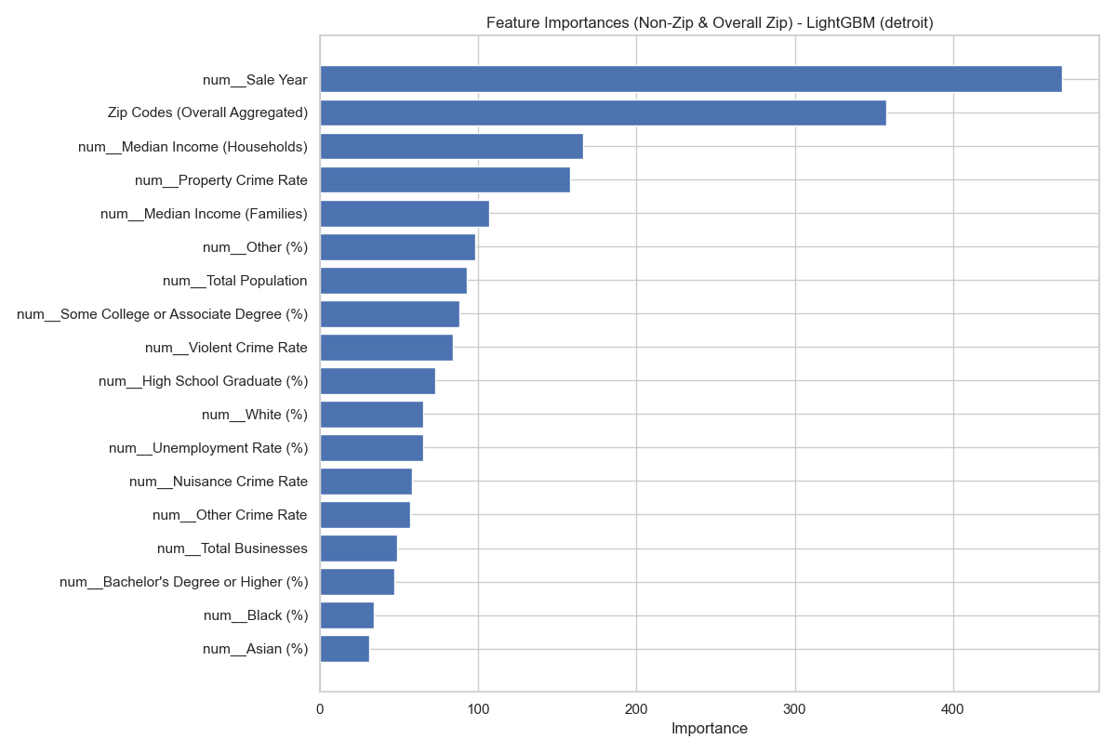
LightGBM Feature Importance Detroit (R² : 0.1029)
Sale year
Zipcode
Median Income (Households)
Property Crime Rate
Median Income (Families)
Other Race population %
Total Population
Some College or Associate Degree %
Violent Crime Rate
High School Graduate %

Slide 20
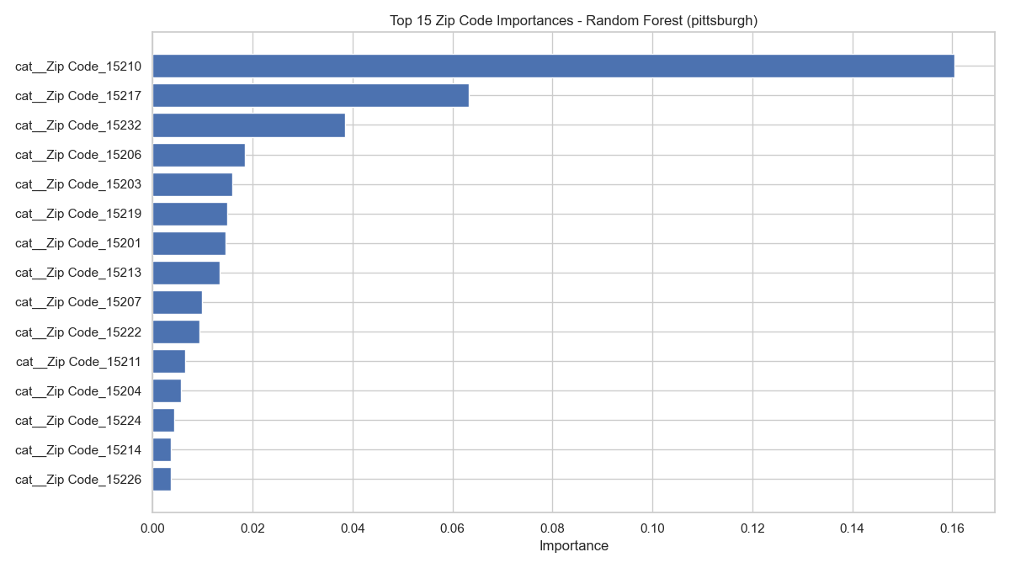
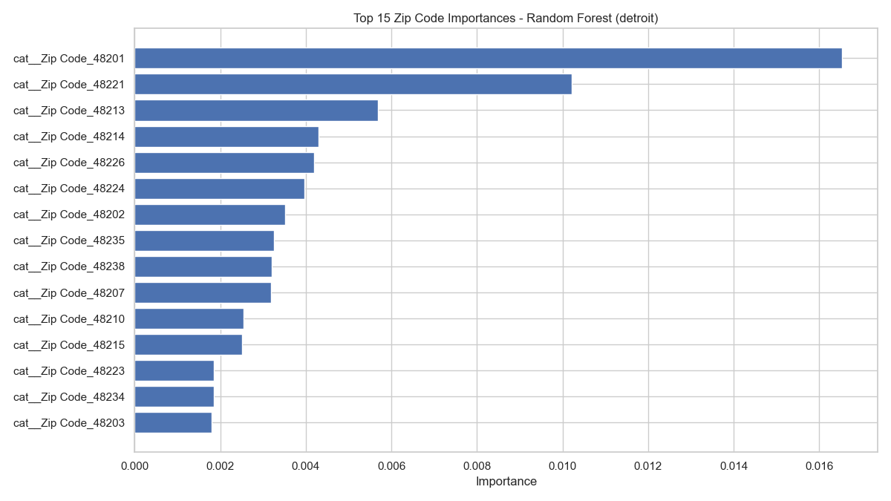
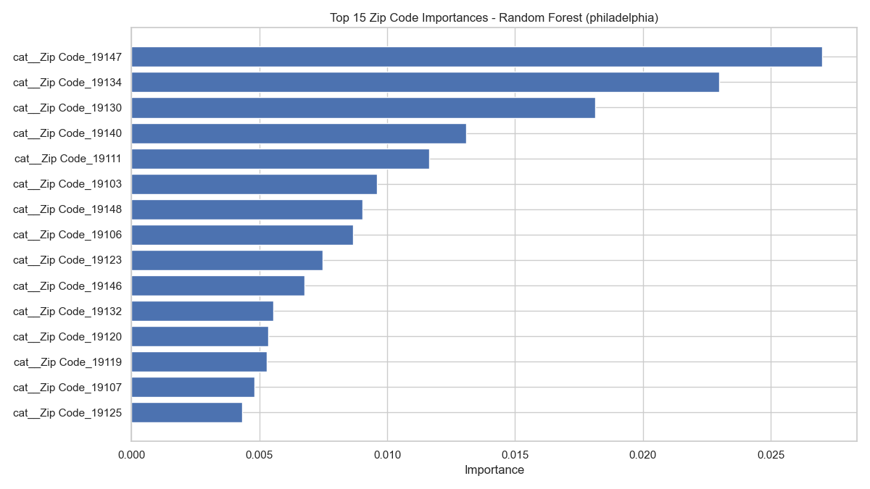
Random Forest Zipcode Importance
Pittsburgh
Detroit
Philadelphia

Slide 21
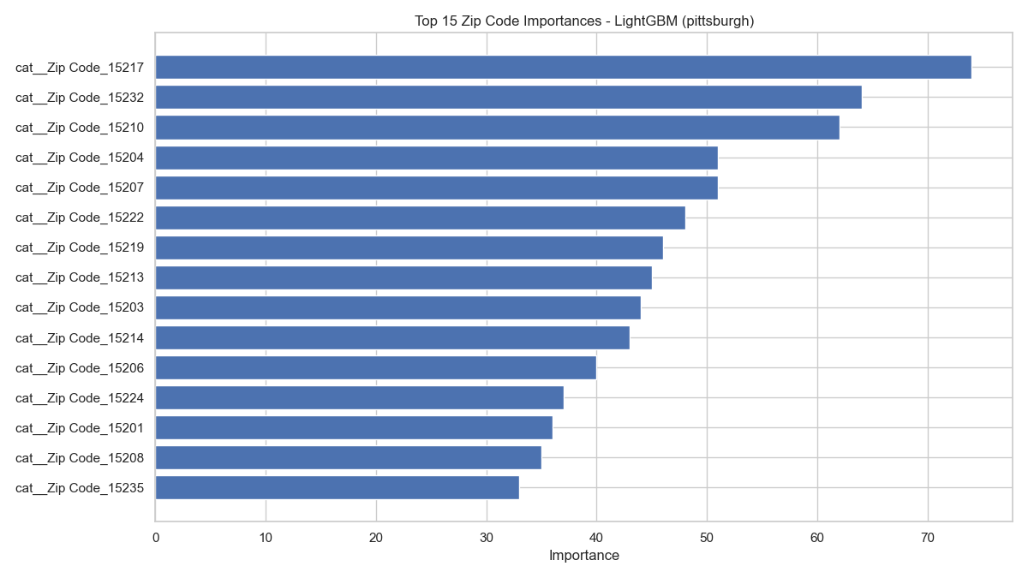
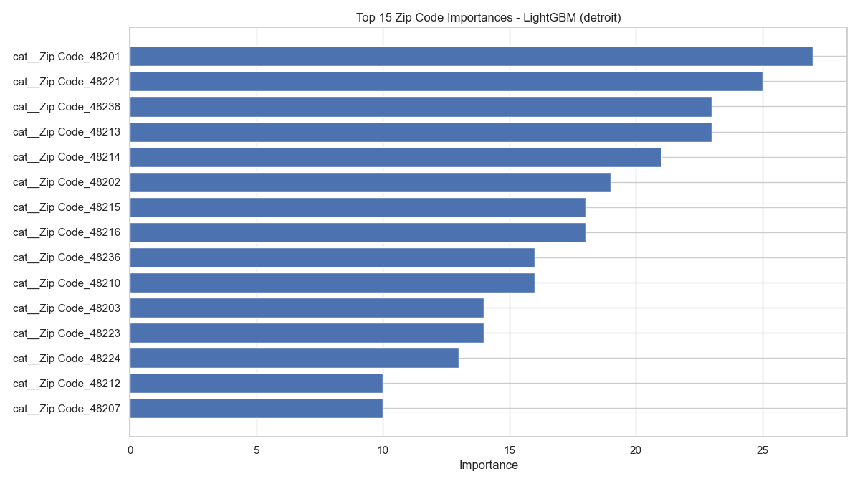
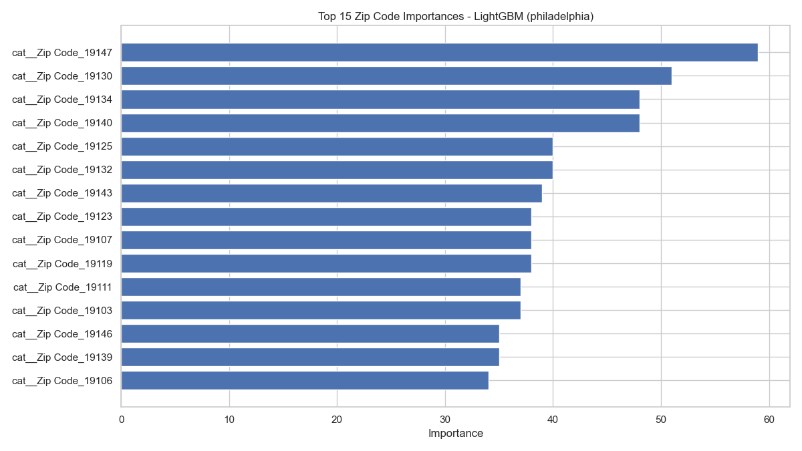
LightGBM Zipcode Importance
Pittsburgh
Detroit
Philadelphia

Slide 22
OLS Regression Philadelphia (R² : 0.218)
Variable | Coefficient | Each unit increase = increase in sale price %
Sale Year | 0.1175 | 12.47
Asian (%) | 0.0158 | 1.59
White (%) | 0.0054 | 0.54
Total Businesses | 0.0031 | 0.31
Other Crime Rate | 0.0011 | 0.11

Slide 23
OLS Regression Pittsburgh (R² : 0.141)
Variable | Coefficient | Each unit increase = increase in sale price %
Sale Year | 0.0710 | 7.36
White (%) | -0.0340 | -3.34
Black (%) | -0.0308 | -3.08
Other (%) | -0.0297 | -2.93
Asian (%) | -0.0281 | -2.77

Slide 24
OLS Regression Detroit (R² : 0.063)
Variable | Coefficient | Each unit increase = increase in sale price %
Nuisance Crime Rate | -1.3481 | -74
Property Crime Rate | -0.5100 | -66.5
Violent Crime Rate | -0.3829 | -31.8
Other Crime Rate | 0.1849 | 20.3
Sale Year | 0.1691 | 18.4

Slide 25
City | R² Score | Top Predictive Features
Philadelphia | 0.51 | Asian %, Median Income, Bachelor’s Degree %
Pittsburgh | 0.38 | Bachelor’s Degree %, Black %, White %
Detroit | 0.46 | Total Businesses, Misc. Crime Rate, Unemployment %
All Cities Combined | 0.33 | Crime Rates, Median Income, Racial Composition
Random Forest Regression achieved improved results by census tract.
Notes:
Ben

Slide 26
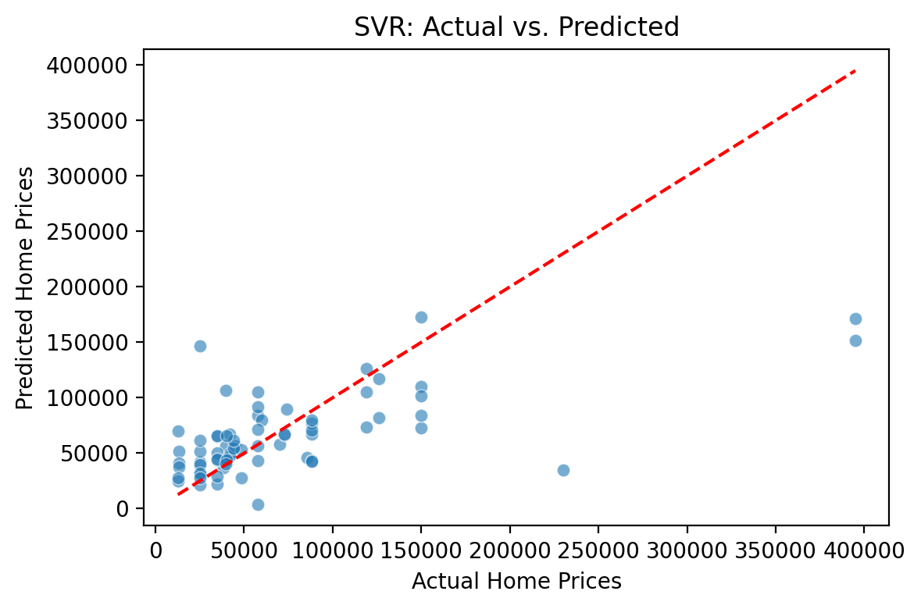
SVR: Actual vs. Predicted (Philly)
Support Vector Regression also modeled average home values effectively.
Notes:
Ben

Slide 27

Traits like income, education, and property crime were strongly associated with home prices.
Racial demographics, bachelor’s degree attainment, crime rates, and unemployment rates held the greatest explanatory power for median neighborhood home value.
Model accuracy varied significantly by city – Philadelphia was the easiest to model, then Pittsburgh, then Detroit.
More advanced regression models were more effective, especially log-linear, random forest, and SVR
The greatest r-squared values in our analysis belonged to the Philly RFR model (0.51) and the Detroit SVR model (0.48).
Notes:
Ben

Slide 28
Stakeholder Implications
Developers
Identify good locations for their market segments (e.g., affordable housing, luxury housing).
Policy Makers
Develop certain policies to deter or encourage neighborhood characteristics to increase overall neighborhood value.
House buyers
Define budget and characteristic they want in a neighborhood to purchase a home.
Notes:
JS

Slide 29
Ethical / Societal Implications
Developers should not use this type of analysis to avoid building affordable housing in neighborhoods that need it.
Home buyers should be wary of associations between demographics and home values that may be based on prejudice.
Local policy makers should not pursue higher neighborhood home values at the expense of quality of life for residents.
Notes:
Ben

Slide 30
Legal Implication
Using protected attributes (e.g., race) to make development decisions would be illegal.
Failing to update neighborhood infrastructure based on low home values could cause a class-action suit.
Notes:
JS

Slide 31
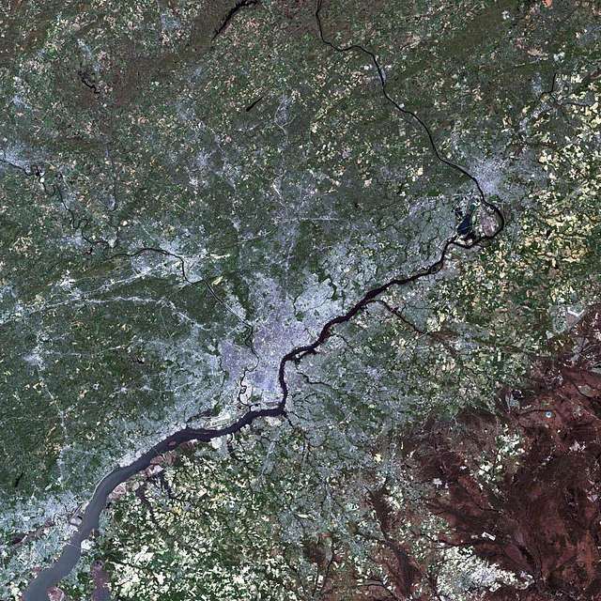
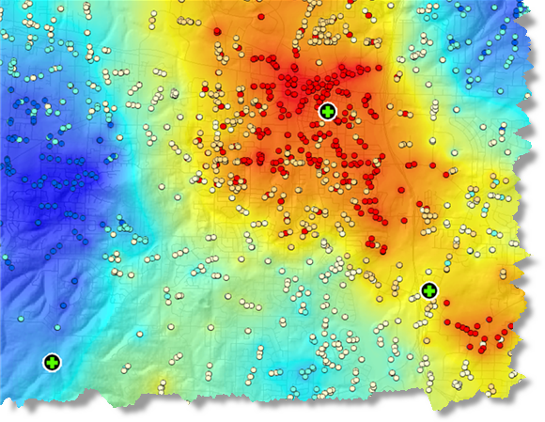

Future research should consider using satellite imagery, spatial regression, and more advanced ML models.
Preliminary research shows that using satellite imagery in addition to neighborhood or property data can help predict home prices.
Neural Networks (or their variations, RNN and CNN) may help uncover complex non-linear relationships.
Spatial regression analysis is an alternative model that may be better suited for geographic analysis of home values.
Notes:
Ben

